Slide 1


BOOTSTRAP
Lecture-14

Slide 2
Today’s Agenda
BootStrap NavBar
NavBar Brand
Adding Images
Adding Links
Adding DropDown

Slide 3
BootStrap NavBar
The navigation header, or the navbar, should be created using the <nav> tag or a <div> tag with the role=”navigation” attribute.
In order to get the Bootstrap 4 styling, we will need the basic class called .navbar.
By default, the navbar takes up the whole width of the screen

Slide 4
NavBar Brand
The first element that usually sits in a navbar is the brand.
To make it stand out from the rest of elements in the navbar, we need the .navbar-brand class.
We can use it with links or other tags (such as <span>, <h[size]>, <div>).

Slide 5
Example
<nav class="navbar navbar-dark bg-dark">
<a class="navbar-brand" href="#a">ScaLive</a>
</nav>
<nav class="navbar navbar-dark bg-dark mt-3">
<span class="navbar-brand mb-0 h1">ScaLive</span>
</nav>

Slide 6
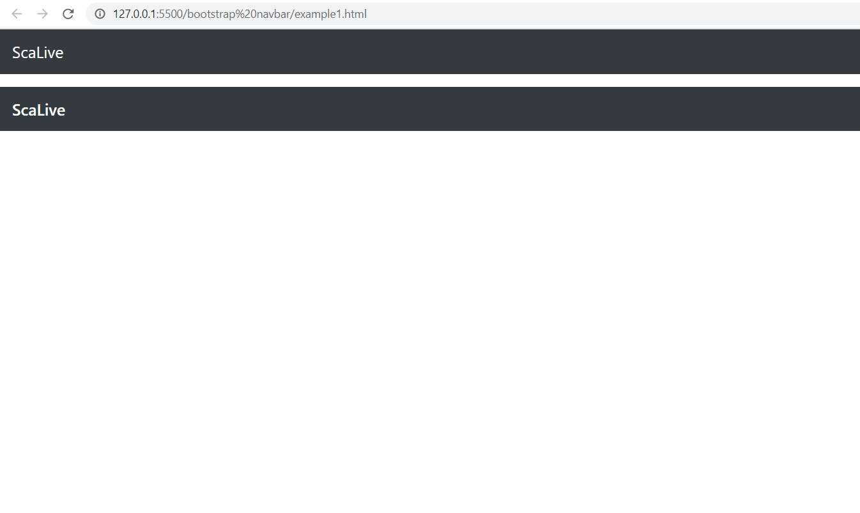
Output

Slide 7
Adding Image To NavBar
We can also place a logo inside the .navbar-brand.
To do this we just have to add the <img> tag with the relevant image

Slide 8
Example
<nav class="navbar navbar-dark bg-dark">
<a class="navbar-brand" href="#a"><img src="../images/scalivelogo.png" alt="logo"></a>
</nav>

Slide 9
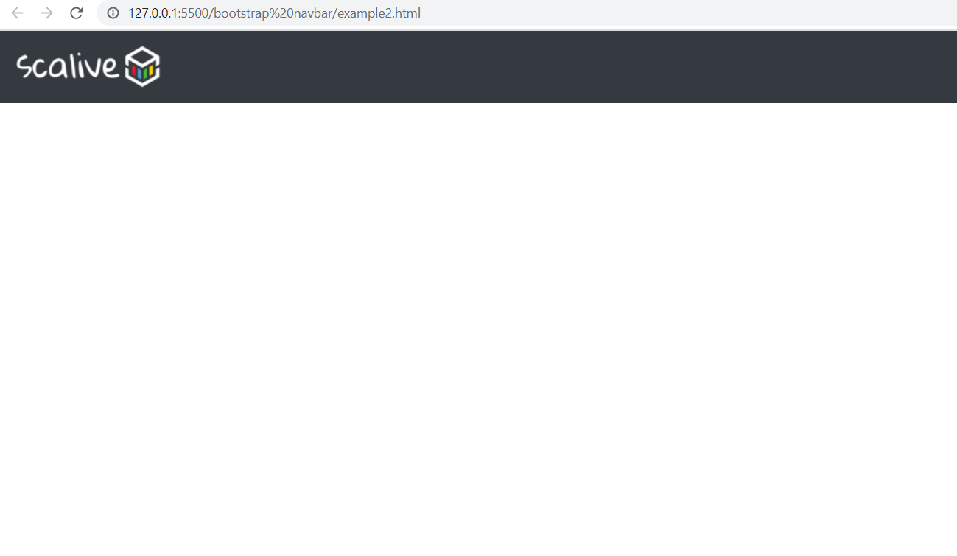
Output

Slide 10
Adding Links To NavBar
The next thing commonly found in navigation bars after the brand is a list of links horizontally aligned.
To make use of the Bootstrap 4 design, we should add the .navbar-nav class to the <ul> list of elements and the .nav-item class to each element.
The links should get the .nav-link class

Slide 11
Example
<nav class="navbar navbar-dark bg-dark">
<a class="navbar-brand" href="#">
<img src="../images/scalivelogo.png" alt="logo">
</a>
<ul class="navbar-nav">
<li class="nav-item active">
<a class="nav-link" href="#">Home </a>
</li>
<li class="nav-item">
<a class="nav-link" href="#">About Us</a>
</li>
<li class="nav-item">
<a class="nav-link" href="#">Courses</a>
</li>
</ul>
</nav>

Slide 12
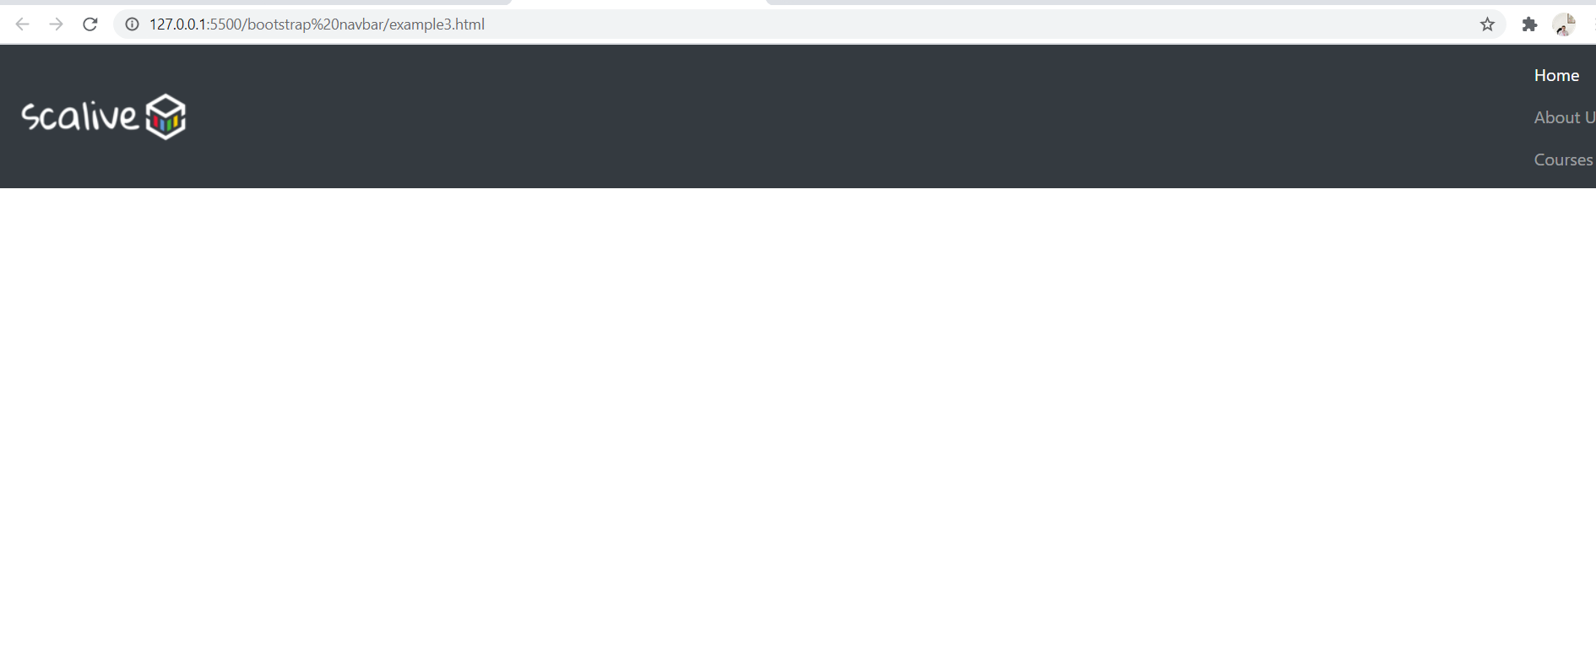
Output

Slide 13
Adding Links To NavBar
This is not what we are actually trying to do since we want a horizontal list of links.
In order to get there, we need to understand this default behaviour.

Slide 14
Adding Links To NavBar
The list of links appears vertically because this is the behaviour for mobile devices (and Bootstrap 4 is a mobile-first library).
So this appearance is by design.

Slide 15
Adding Links To NavBar
But, even so, this behaviour is not entirely what we want for mobile devices.
Since it will take up most of the space on a mobile display, the common practice is to have a toggle button that collapses the menu.

Slide 16
Adding Links To NavBar
In order to be able to toggle the list of links on mobile, we need to wrap it in a div with the classes .collapse and .navbar-collapse and also assign to it an unique id.
And we need a toggler that triggers the collapse action for the list with the given id.

Slide 17
Example
<nav class="navbar navbar-dark bg-dark">
<a class="navbar-brand" href="#">
<img src="../images/scalivelogo.png" alt="logo">
</a>
<button class="navbar-toggler" type="button" data-toggle="collapse" data-target="#navbar-list">
<span class="navbar-toggler-icon"></span>
</button>
<div class="collapse navbar-collapse" id="navbar-list">
<ul class="navbar-nav">
<li class="nav-item active">
<a class="nav-link" href="#">Home </a>
</li>
<li class="nav-item">
<a class="nav-link" href="#">About Us</a>
</li>
<li class="nav-item">
<a class="nav-link" href="#">Courses</a>
</li>
</ul>
</div>
</nav>

Slide 18
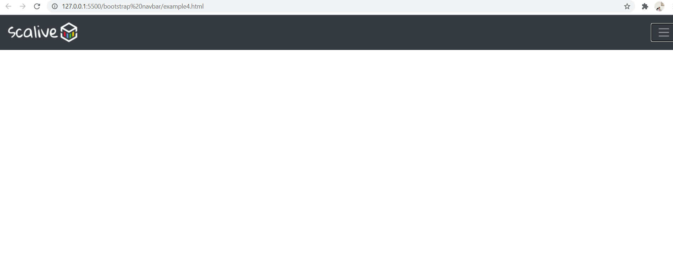
Output

Slide 19
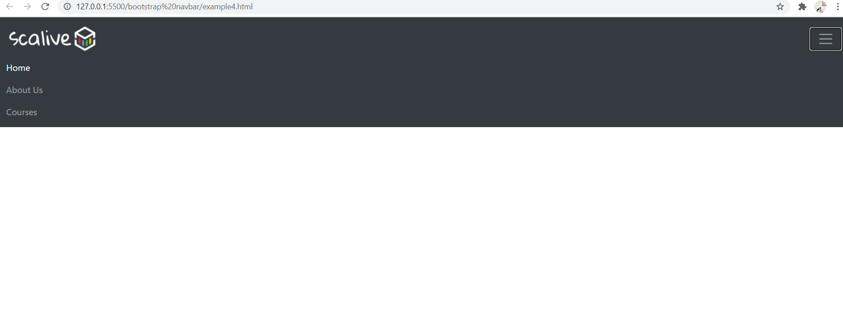
Output

Slide 20
Responsive NavBar
If we leave the Bootstrap 4 navbar like that, still it will show the responsive behaviour.
But , regardless of the screen resolution we are on, we will see a burger menu button and when we press it, we will see the list of links arranged vertically.

Slide 21
Responsive NavBar
But, if we want to show the links in a horizontal format, we can do that by specifying the breakpoint where we want to start seeing this behaviour with the class .navbar-expand-[breakpoint].
So, if we want for the menu to be horizontal starting with large mobile devices, we will need the .navbar-expand-sm class

Slide 22
Example
<nav class="navbar navbar-dark bg-dark navbar-expand-sm">
<a class="navbar-brand" href="#">
<img src="../images/scalivelogo.png" alt="logo">
</a>
<button class="navbar-toggler" type="button" data-toggle="collapse" data-target="#navbar-list">
<span class="navbar-toggler-icon"></span>
</button>
<div class="collapse navbar-collapse" id="navbar-list">
<ul class="navbar-nav">
<li class="nav-item active">
<a class="nav-link" href="#">Home </a>
</li>
<li class="nav-item">
<a class="nav-link" href="#">About Us</a>
</li>
<li class="nav-item">
<a class="nav-link" href="#">Courses</a>
</li>
</ul>
</div>
</nav>

Slide 23
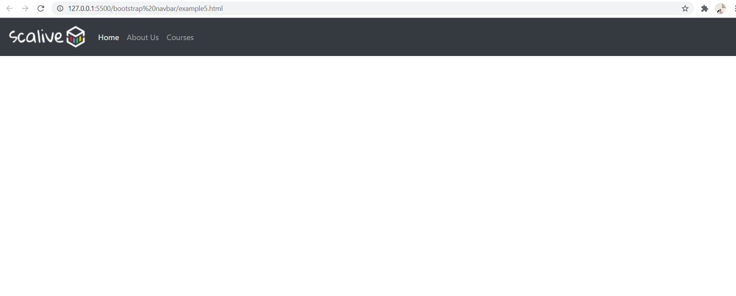
Output

Slide 24
Adding DropDown To NavBar
We can add dropdowns to the navbar.
We will need for the .dropdown class to be placed together with the .nav-item class.

Slide 25
Adding DropDown To NavBar
This element will contain both the dropdown toggler and the dropdown menu.
The toggler needs the .nav-link class (the same as any other link in the navbar) and the .dropdown-menu has the standard syntax.

Slide 26
Example
<nav class="navbar navbar-dark bg-dark navbar-expand-sm">
<a class="navbar-brand" href="#">
<img src="../images/scalivelogo.png" alt="logo">
</a>
<button class="navbar-toggler" type="button" data-toggle="collapse" data-target="#navbar-list">
<span class="navbar-toggler-icon"></span>
</button>
<div class="collapse navbar-collapse" id="navbar-list">
<ul class="navbar-nav">
<li class="nav-item active">
<a class="nav-link" href="#">Home </a>
</li>
<li class="nav-item">
<a class="nav-link" href="#">About Us</a>
</li>
<li class="nav-item dropdown">
<a class="nav-link dropdown-toggle" href="#" role="button" data-toggle="dropdown"> Courses</a>
<div class="dropdown-menu">
<a class="dropdown-item" href="#">Java</a>
<a class="dropdown-item" href="#">Python</a>
<a class="dropdown-item" href="#">JavaScript</a>
</div>
</li>
</ul>
</div>
</nav>

Slide 27
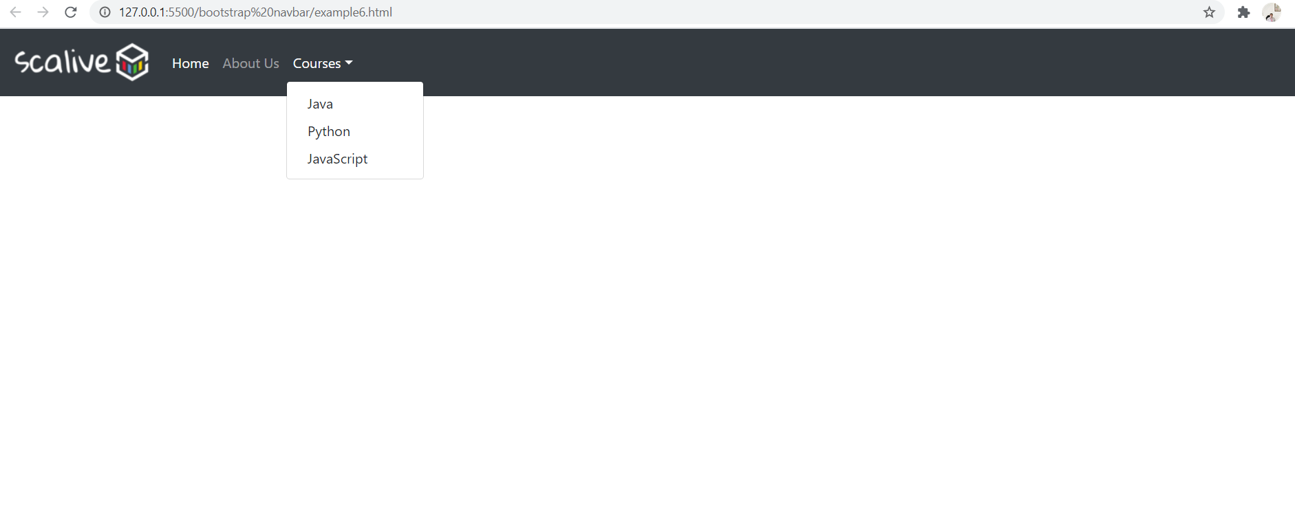
Output

Slide 28
Adding Images To NavBar
Oftentimes, we need to show images in the navbar as thumbnails for logged in users.
We can do this by using the Bootstrap 4 border utilities and alignment utilities.

Slide 29
Example
<nav class="navbar navbar-dark bg-dark navbar-expand-sm">
<a class="navbar-brand" href="#">
<img src="../images/scalivelogo.png" alt="logo">
</a>
<span class="custom-navbar-image mx-4">
<img src="../images/sachin.jpg" width="40" height="40" class="rounded-circle">
</span>
<span class="custom-navbar-image mx-4">
<img src="../images/seema.jpg" width="40" height="40" class="rounded-circle">
</span>
<span class="custom-navbar-image mx-4">
<img src="../images/team.jpg" width="40" height="40" class="rounded-circle">
</span>
</nav>

Slide 30
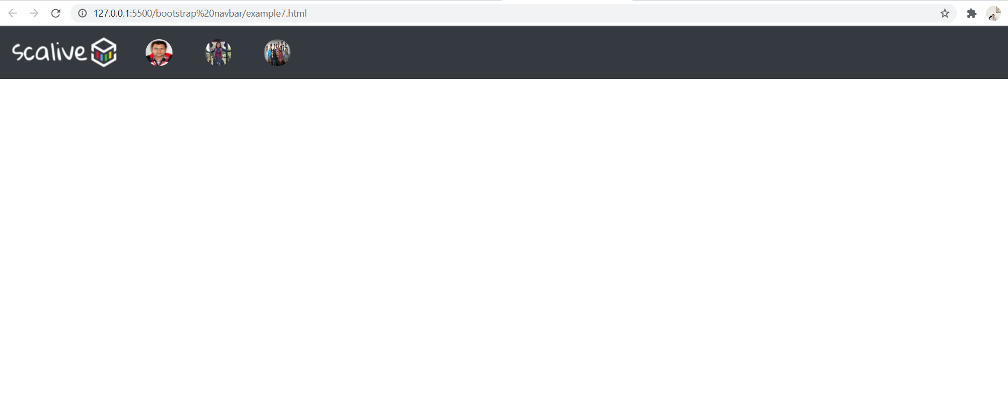
Output

Slide 31
Pulling Elements To Right
We can pull the menu with the links to the right.
To do this we need to apply the .ml-auto on the .navbar-nav element.

Slide 32
Pulling Links To Right
<nav class="navbar navbar-dark bg-dark navbar-expand-sm">
<a class="navbar-brand" href="#">
<img src="../images/scalivelogo.png" alt="logo">
</a>
<button class="navbar-toggler" type="button" data-toggle="collapse" data-target="#navbar-list">
<span class="navbar-toggler-icon"></span>
</button>
<div class="collapse navbar-collapse" id="navbar-list">
<ul class="navbar-nav ml-auto">
<li class="nav-item active">
<a class="nav-link" href="#">Home </a>
</li>
<li class="nav-item">
<a class="nav-link" href="#">About Us</a>
</li>
<li class="nav-item">
<a class="nav-link" href="#">Courses</a>
</li>
</ul>
</div>
</nav>

Slide 33
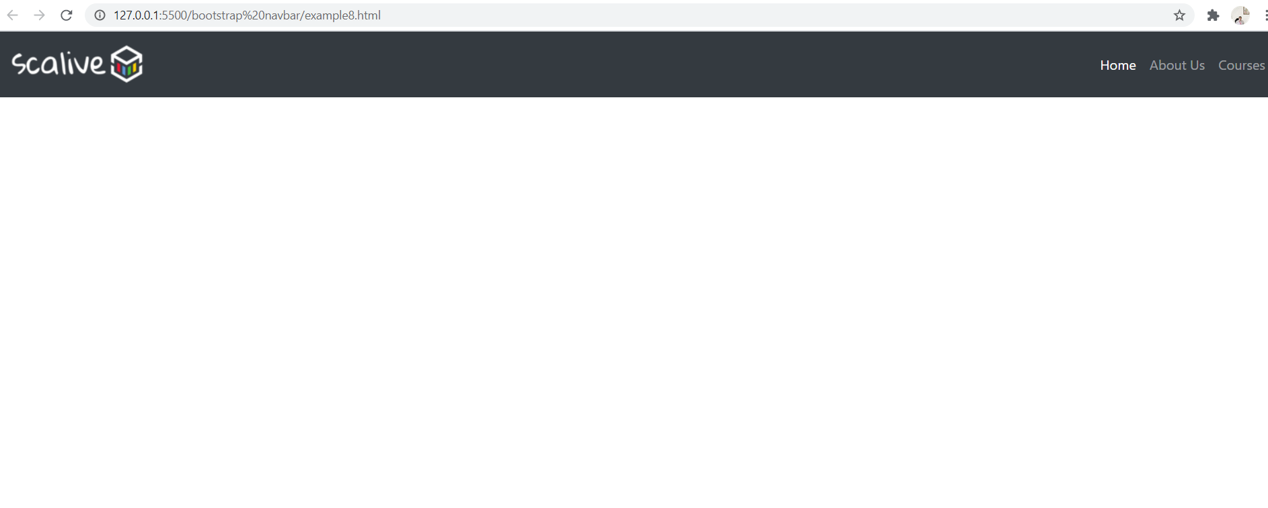
Output

Slide 34
Pulling Links To Center
<nav class="navbar navbar-dark bg-dark navbar-expand-sm">
<a class="navbar-brand" href="#">
<img src="../images/scalivelogo.png" alt="logo">
</a>
<button class="navbar-toggler" type="button" data-toggle="collapse" data-target="#navbar-list">
<span class="navbar-toggler-icon"></span>
</button>
<div class="collapse navbar-collapse" id="navbar-list">
<ul class="navbar-nav mx-auto">
<li class="nav-item active">
<a class="nav-link" href="#">Home </a>
</li>
<li class="nav-item">
<a class="nav-link" href="#">About Us</a>
</li>
<li class="nav-item">
<a class="nav-link" href="#">Courses</a>
</li>
</ul>
</div>
</nav>

Slide 35
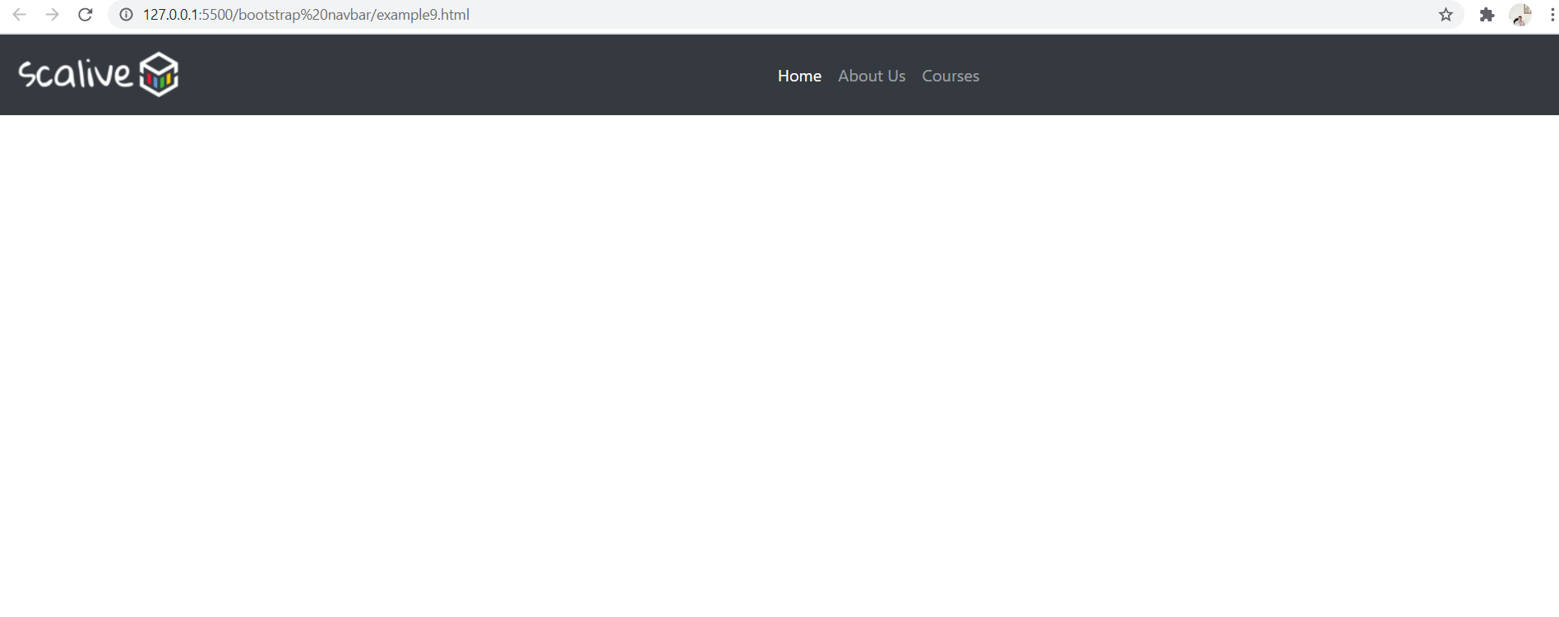
Output

Slide 36
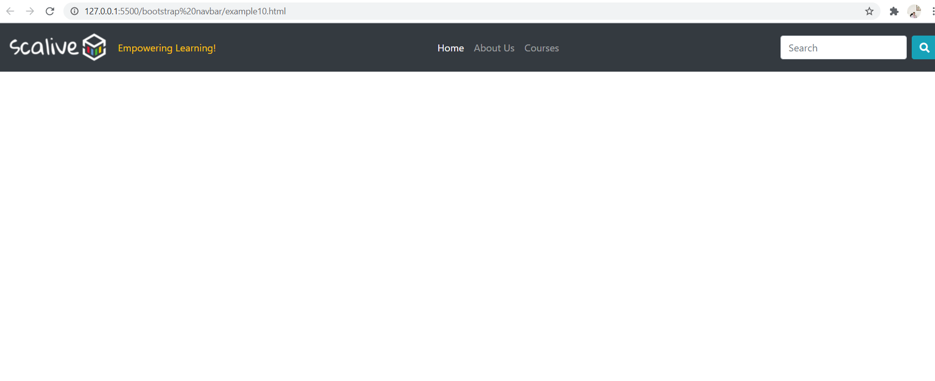
Assignment

